Slide 1


^{CE4055} ^{LAB:3}
CODE Analysis of Firmware and PAT

Slide 2
We will learn:
Writing firmware for AVR MCUs
UART Communication
Code analysis of SCA Firmware code
Code analysis of PAT tool (CPA)

Slide 3
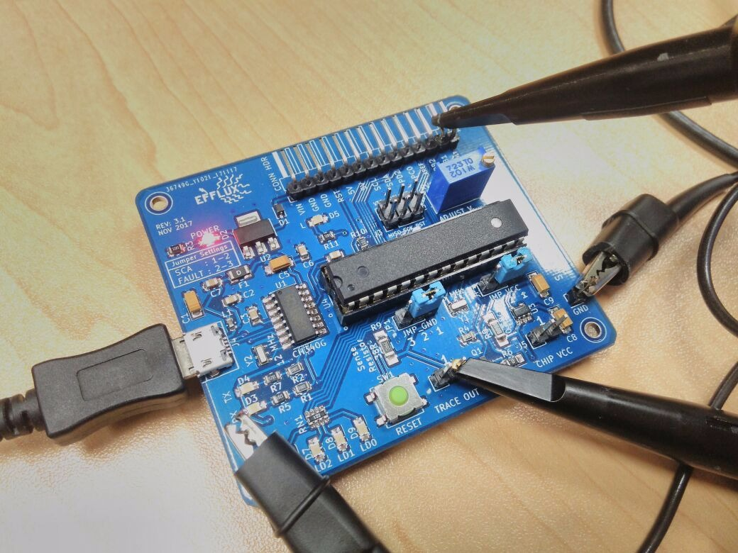
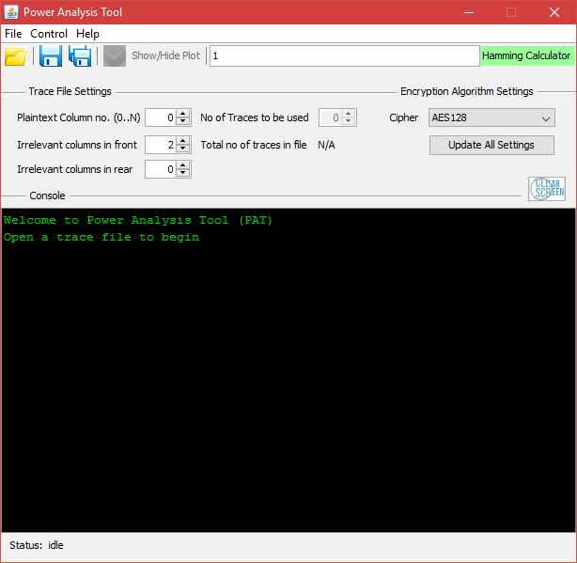
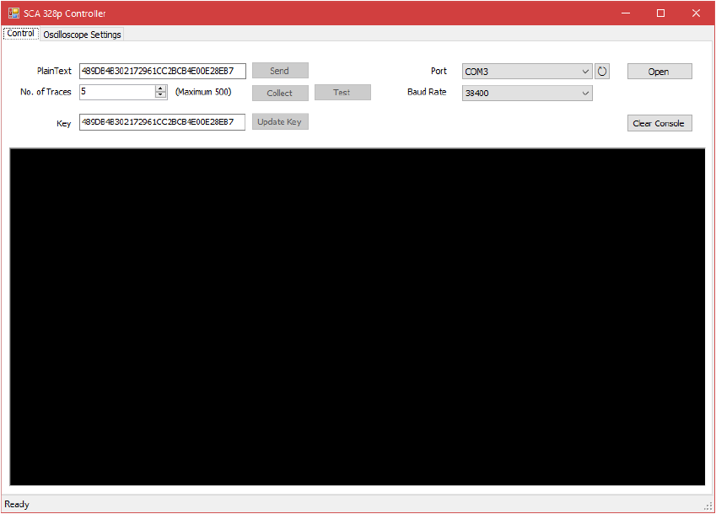
Software/Firmware used
Software
Written in C#
Serial Communication
Oscilloscope settings
Saving waveforms to file
Communicates with both Oscilloscope and AVR board
Firmware
Written in Embedded C
AES code
UART controller
AES controller
Communicates with PC
Sends binary signal to oscilloscope
Software
Written in JAVA
Reads trace files
Performs CPA
No communication with other tools or devices

Slide 4
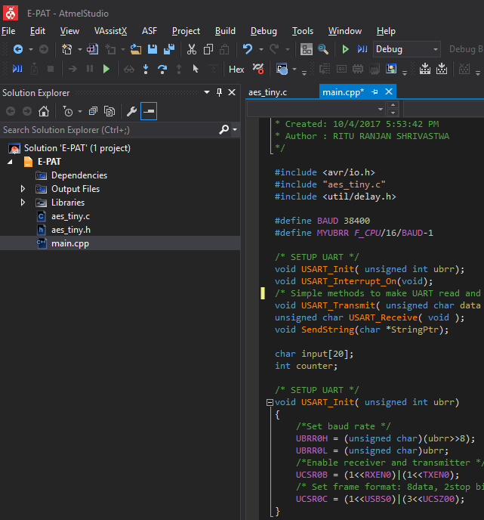
Firmware coding into AVR Microcontroller
Download ATMEL Studio – the perfect IDE for AVR coding
Write code in Embedded C
Burn code into MCU using AVR ISP or other programmer or simply use Arduino programmer if bootloader already present on chip

Slide 5
Understanding the SCA Firmware code
#define BAUD 38400
#define MYUBRR F_CPU/16/BAUD-1
/* SETUP UART */
void USART_Init( unsigned int ubrr){
/*Set baud rate */
UBRR0H = (unsigned char)(ubrr>>8);
UBRR0L = (unsigned char)ubrr;
/*Enable receiver and transmitter */
UCSR0B = (1<<RXEN0)|(1<<TXEN0);
/* Set frame format: 8data, 2stop bit */
UCSR0C = (1<<USBS0)|(3<<UCSZ00);
}
//uart transmit receive functions
. void SendBytes(unsigned char *StringPtr, int length){..}
. uint8_t readByte(){..}
//
uint8_t pre[] = {0x01, 0x23, 0xAB, 0xCD};
uint8_t key[] = {0x48, 0x9D, 0xB4, 0xB3, 0xF3, 0x17, 0x29, 0x61, 0xCC, 0x2B, 0xCB, 0x4E, 0xD2, 0xE2, 0x8E, 0xB7};
void DoStuff()
{
uint8_t plaintext[16];
for(int i=0; i < 16 ; i++)
{
plaintext[i] = readByte();
}
aes128_enc_tiny_full(plaintext, key);
SendBytes(pre, 4);
SendBytes(plaintext, 16);
}
void updateKey(){
uint8_t newkey[16];
for(int i=0; i < 16 ; i++)
{
newkey[i] = readByte();
}
for(int i=0; i < 16 ; i++)
{
key[i] = newkey[i];
}
}
int main(void){
//Setup Serial
USART_Init(MYUBRR);
DDRB = 0x02; //using PB1 for trigger
PORTB = 0x00; //turning low
while(1)
{
if(readByte() == 0x01)
{
if(readByte() == 0x23)
{
if(readByte() == 0xAB)
{
if(readByte() == 0xCD)
{
DoStuff();
}
}
}
}
else
{
if(readByte() == 0x67)
{
if(readByte() == 0xAB)
{
if(readByte() == 0xCD)
{
updateKey();
}
}
}
}
_delay_ms(100);
}
}

Slide 6
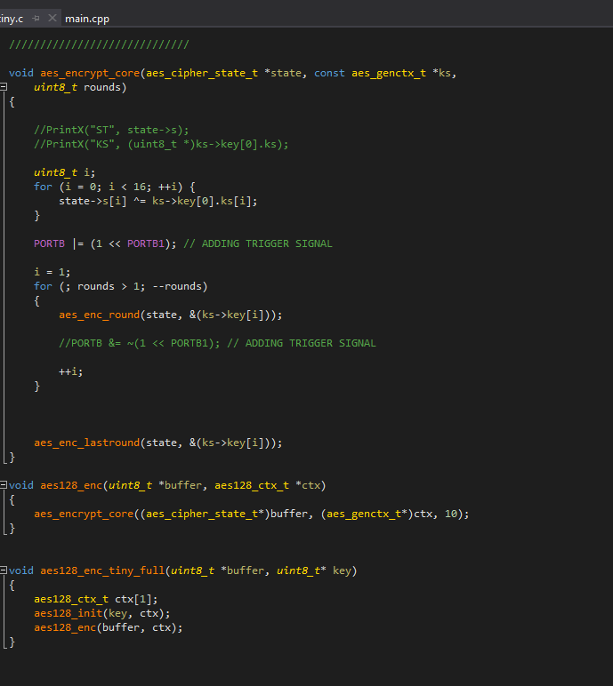
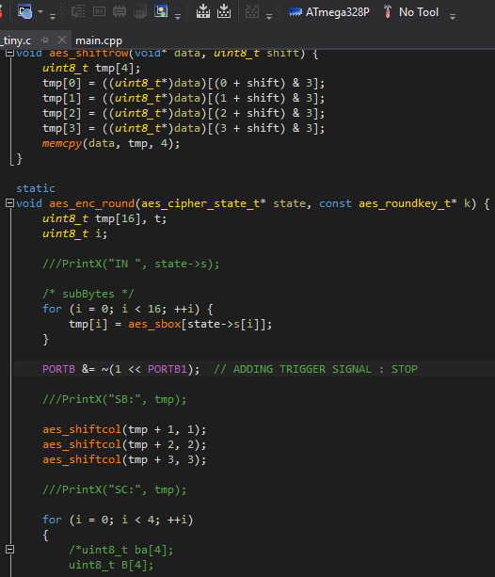
Understanding the SCA Firmware code (contd.)

Slide 7
The Process flow diagram
While (1)
If,
Byte_1=01
Byte_2=23
Byte_3=AB
Byte_4=CD
Next 16 bytes are plaintext
dostuff()
Else If,
Byte_1=45
Byte_2=67
Byte_3=AB
Byte_4=CD
Next 16 bytes are key bytes
updateKey()
aes128_enc_tiny_full(plaintext, key)
firstround()
PORTB = 0x02
State[i] = sbox[state[i]]
PORTB = 0x00

Slide 8
PAT

Slide 9
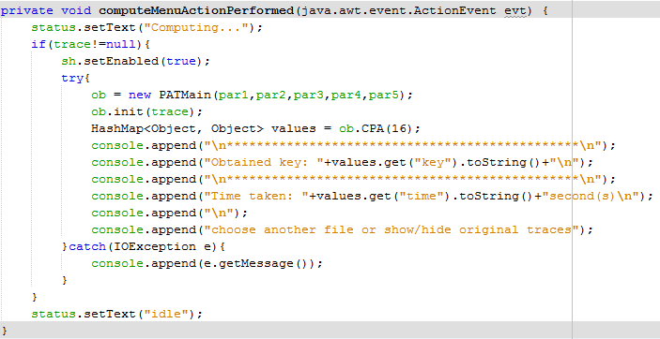
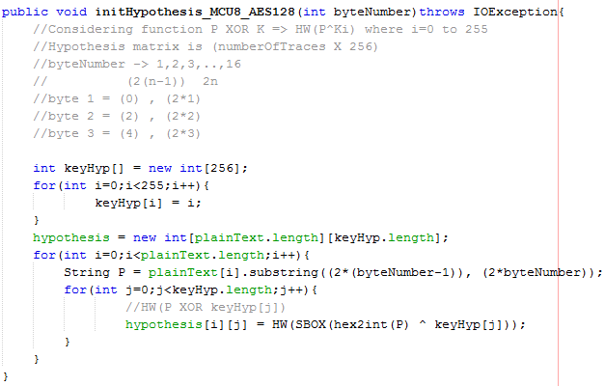
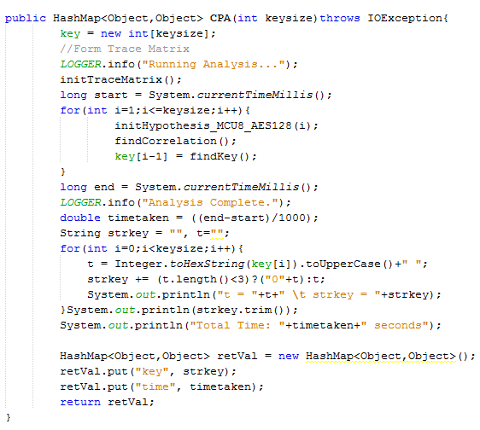
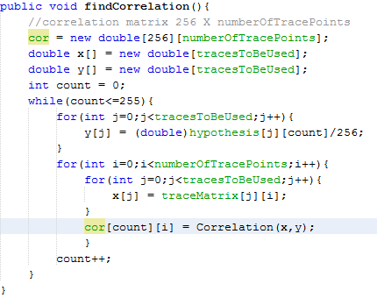
Understanding the PAT Code (CPA)

Slide 10
Lab Copy (Assignment)
To be submitted individually
Should have both lab details in the same report copy
It should contain the following parts for each lab:
Introduction
Proceedings of lab
Inference
Conclusion

Slide 11
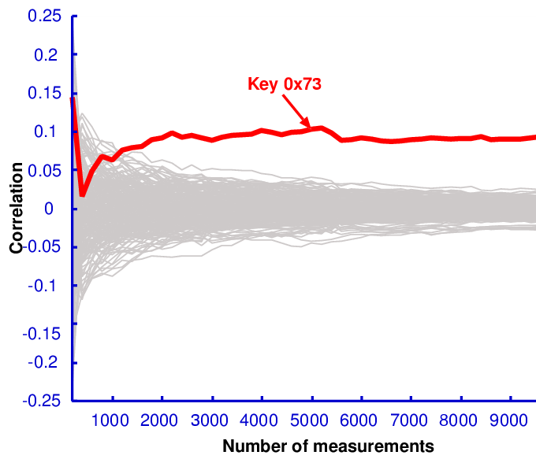
Project Report
To be submitted in a group
Problem statement:
Write Correlation Power Analysis code in any language of your choice and use the collected traces to retrieve the key
The code should be able to generate a graph of “no. of traces vs bits recovered” and “correlation coefficient vs no of traces” as shown in the graph above
Write a brief literature survey of existing countermeasures against power analysis attacks
Conclusion
Each code will be checked for similarities with codes of other students and copying may result to redo the project with different topic

Slide 12
Thank you
Questions?

